Slide 1
Food Ordering Project
Completed under super vision of
Dr. Deepsubhra Guha Ray
Bipasha Mam
Submitted By:
Rishabh Upadhyay | 15 | 12021002016023
Mritunjay Kumar | 10 | 12021002016006
Ayush Chaturvedi | 68 | 22022002016012

Slide 2
Introduction
Serving Vegfood restaurant.
Providing Delicious food and also it has handmade.
Qualitative and hygienic.
Taking Order from customers.
Using Node Js as backend framework.
Using handlebars as JavaScript engine.
Using MySQL database.
Using HTML/CSS for user interface.
Established on oct 2023.

Slide 3
Problems
Not available only veg food site.
Health and Wellness.
Cultural and Religious Considerations.
User Friendly.
Community and Support.
Growing Interest in Plant-Based Diets.

Slide 4
Objectives
To develop a system to properly manage registrant.
To gain Profits.
Second bullet point here.
Third bullet point here.

Slide 5
Used Tools
HTML/CSS (For user interface).
JavaScript (On browser Js).
Node JS (Off Browser Js).
Handlebars (JavaScript template engine).
MySQL DataBase.

Slide 6
Implementation
DataBase:
I have made a database vegfood in which I made three tables customers, orders, feedback.
From customer I have imported name, email, phone from customers table to oeders and feedback table
And used email and phone as primary keyword. In feedback and orders table I have used email as foreign
Key taken from customers table.
Schema of customers table:
customers(username, phone, email, age, password, confirm password)
Schema of orders table
orders( email, plate, location, username, phone, item)
Schema of feedback table
feedback(username, phone, email, feedback)
FrontEnd:
I have used html, hbs template engine, css, javascript, bootstrap for making user interface.

Slide 7
Used Framework
I have used NodeJS, express backend frame work to handle both database and user interface and others.
These are some points which mostly used in backend those are
Sessions(To be logged in).
MySQL (To use database in application).
hbs (To het flexibility in html page).
Express(for the routing and others requirement for backend).
Partials(To write a page as a variable).
Dotenv (To use session and security).

Slide 8
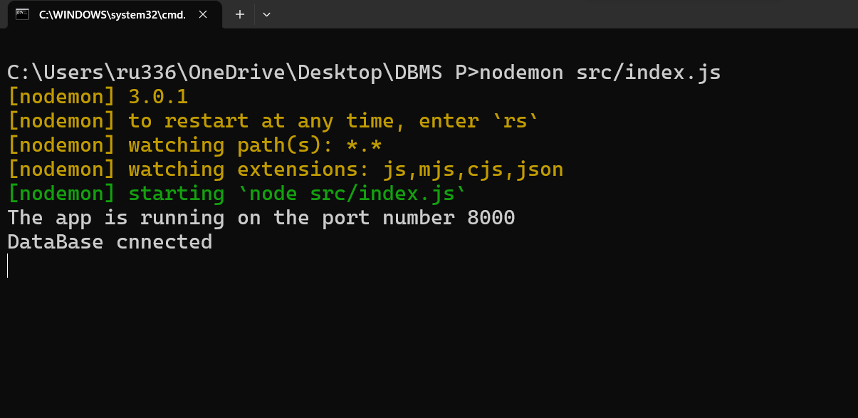
Now I have started my server at port number 8000 which is not a default
Port for any node application.
Now I will share screen shots of all User Interface and DataBase.

Slide 9
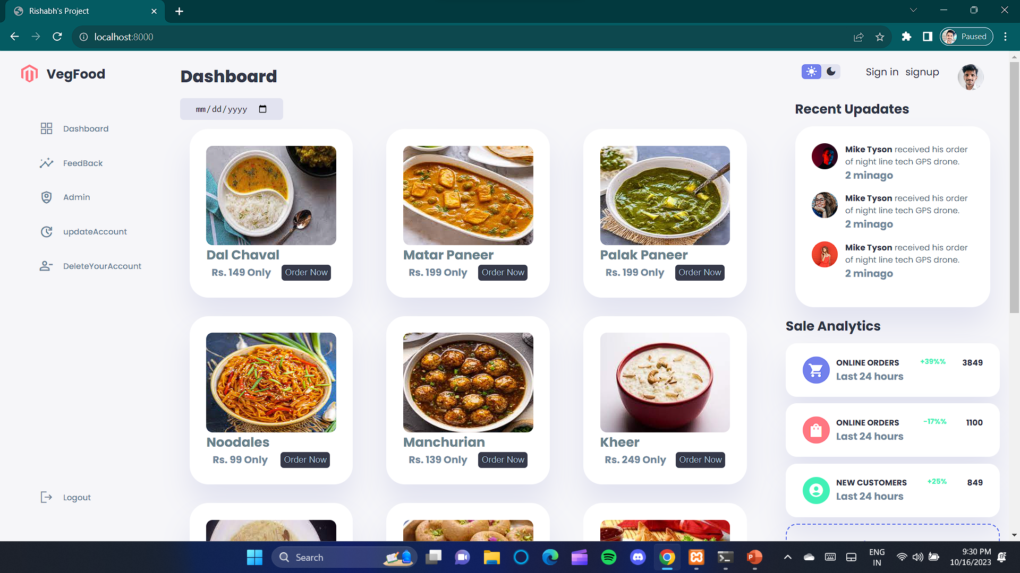
This is home page of my web application.

Slide 10
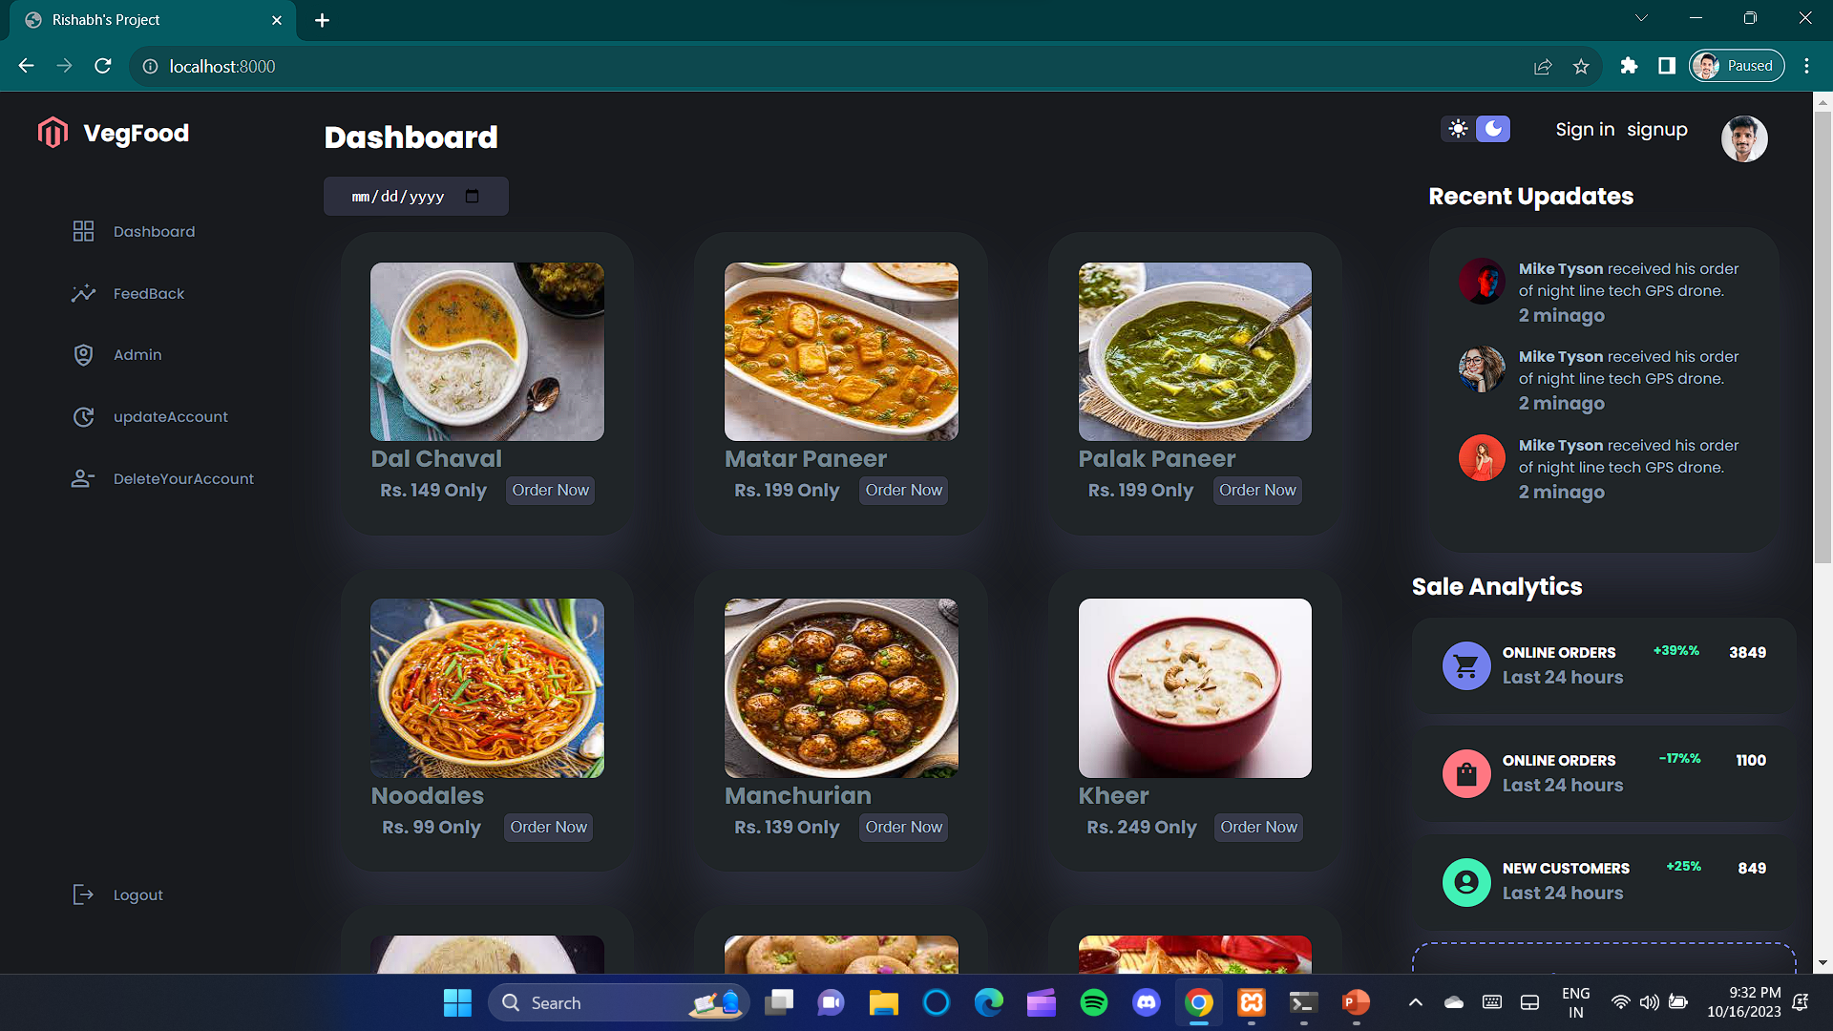
By using this button we can change theme of application.

Slide 11
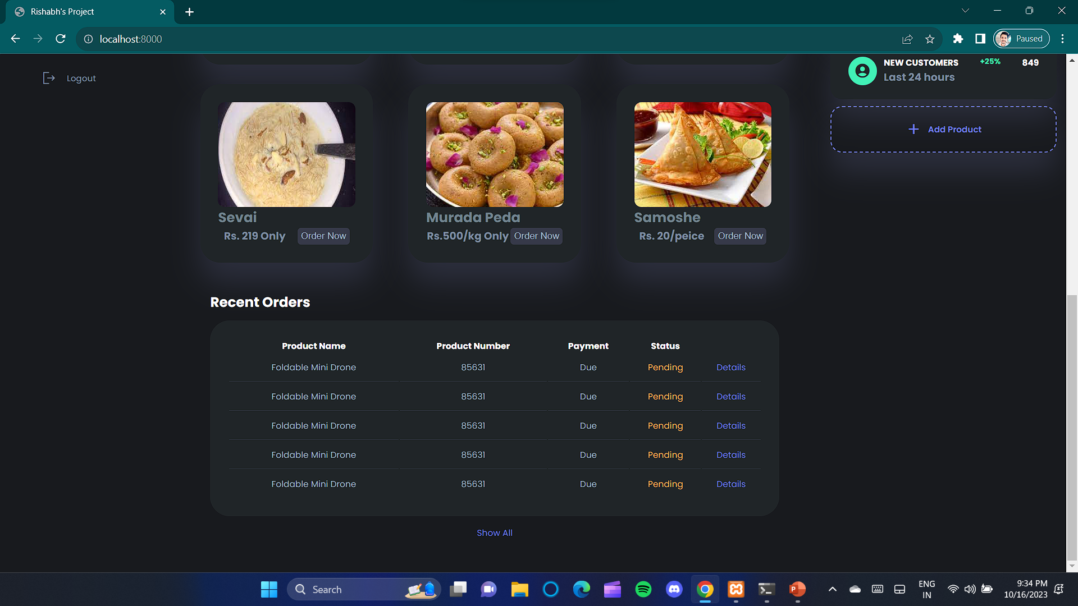
Remaining Home Page at bottom

Slide 12
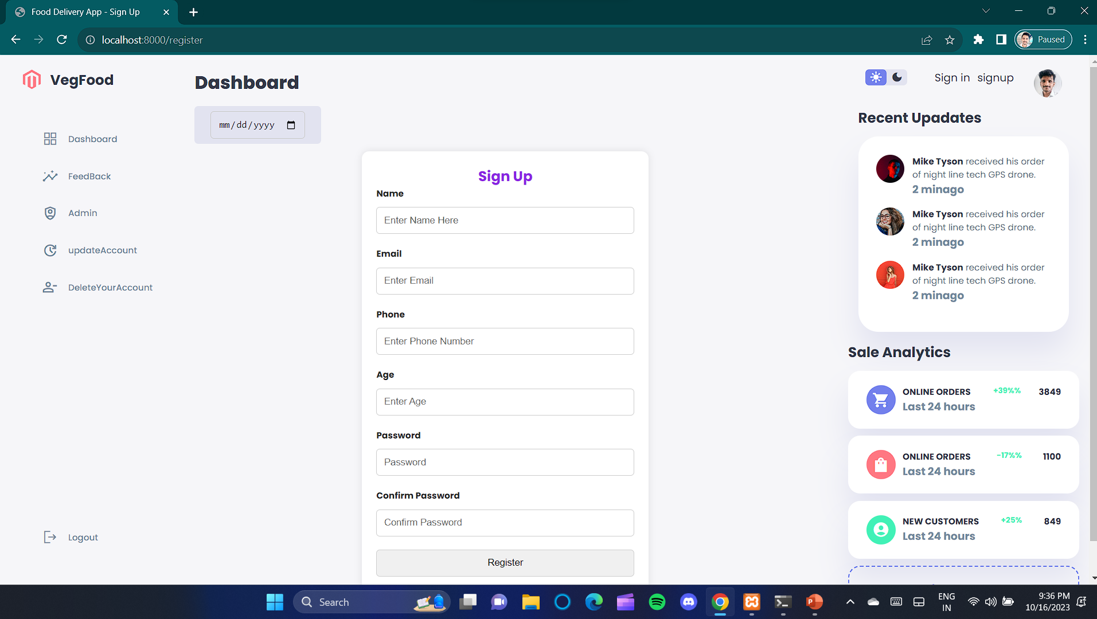
Using This page you can make a
User account.

Slide 13
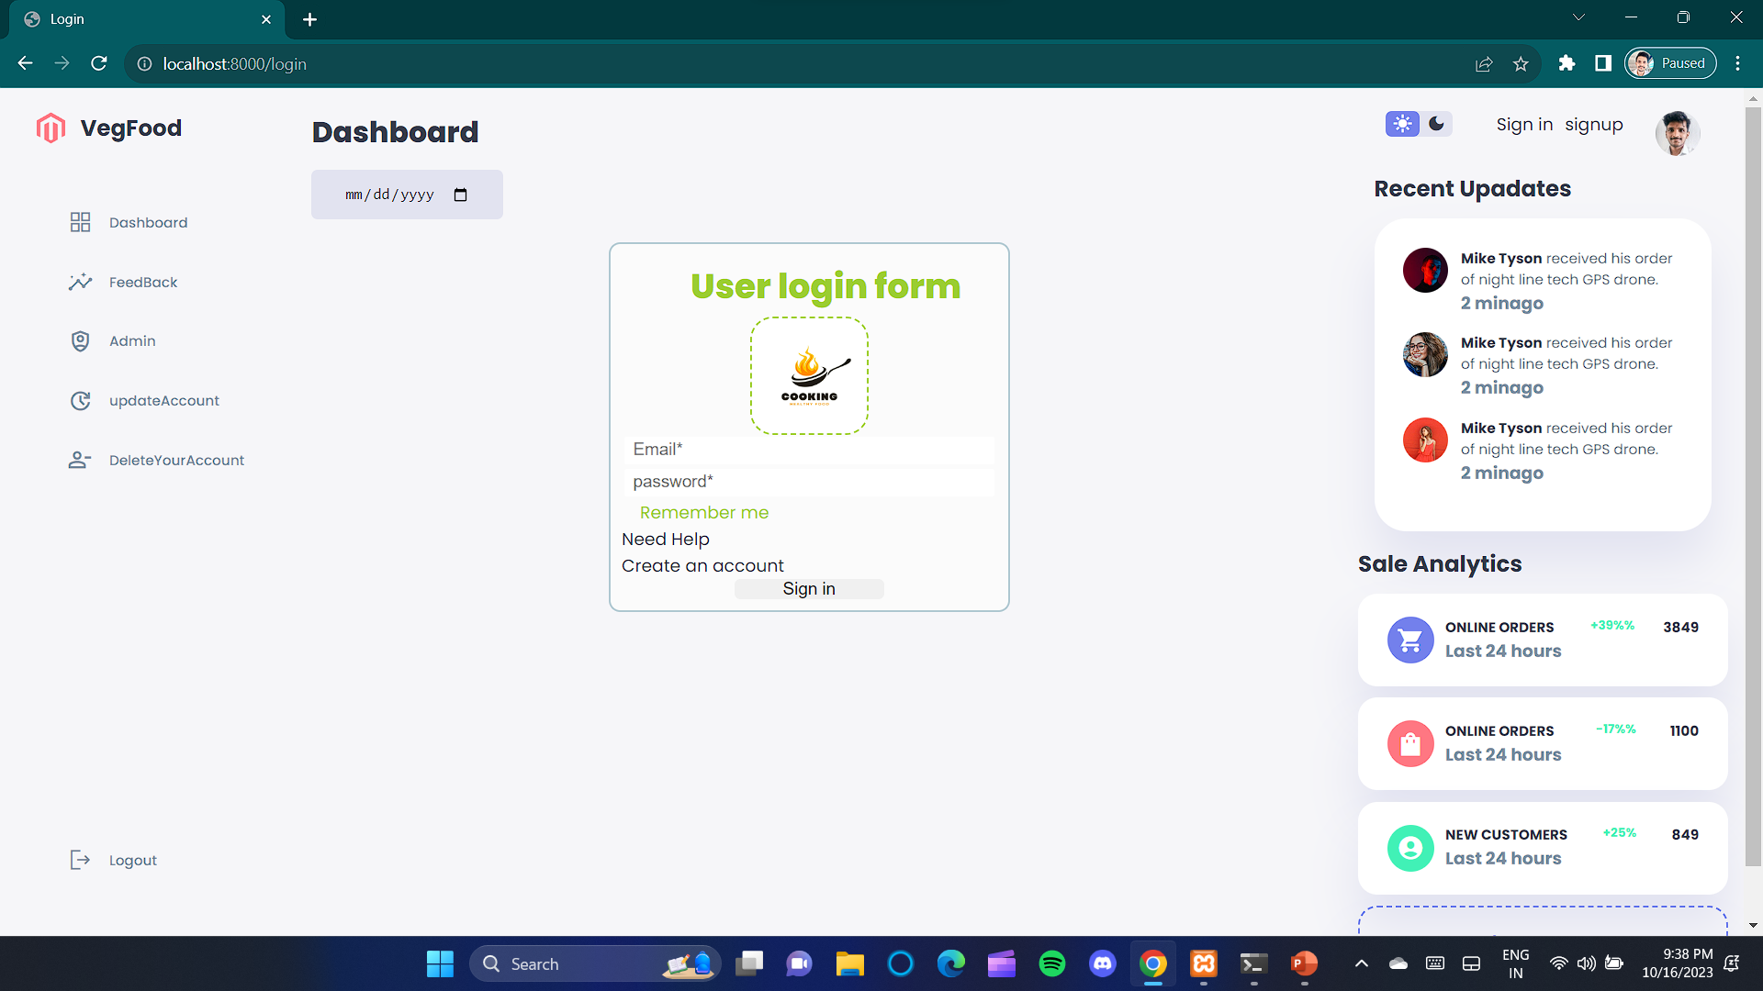
To use all the services you need to login here.

Slide 14
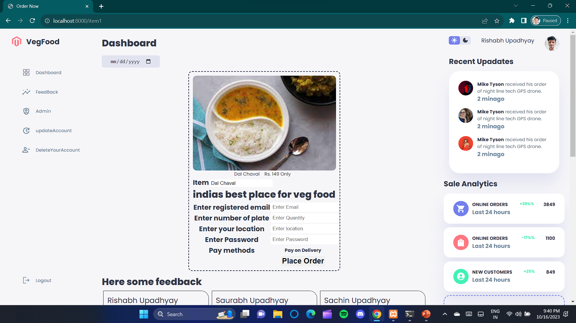
Using this page user can order for wanted Food and after placing order, order details Will be stored in orders table in database vegfood.

Slide 15
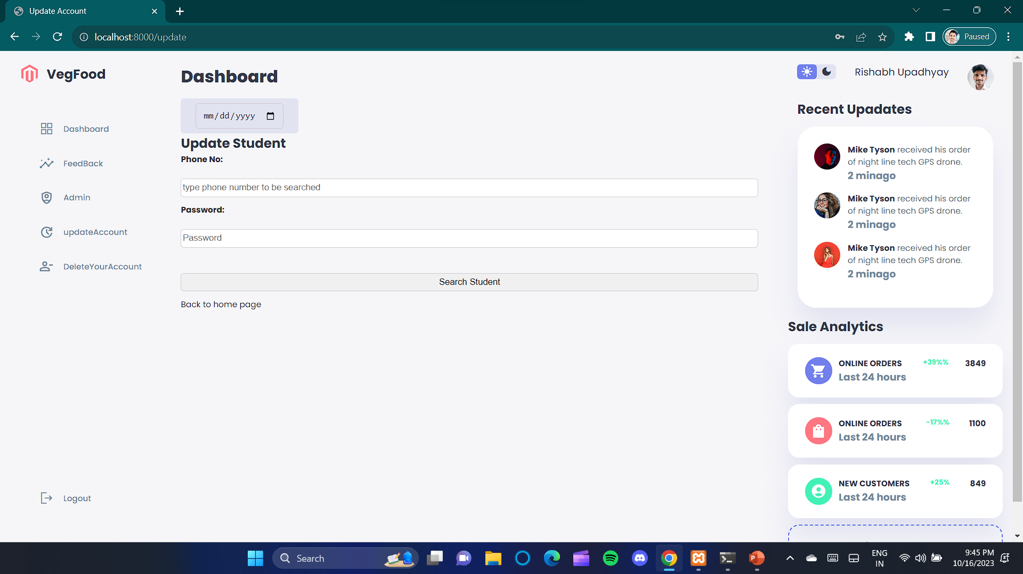
Here you can update you account.

Slide 16
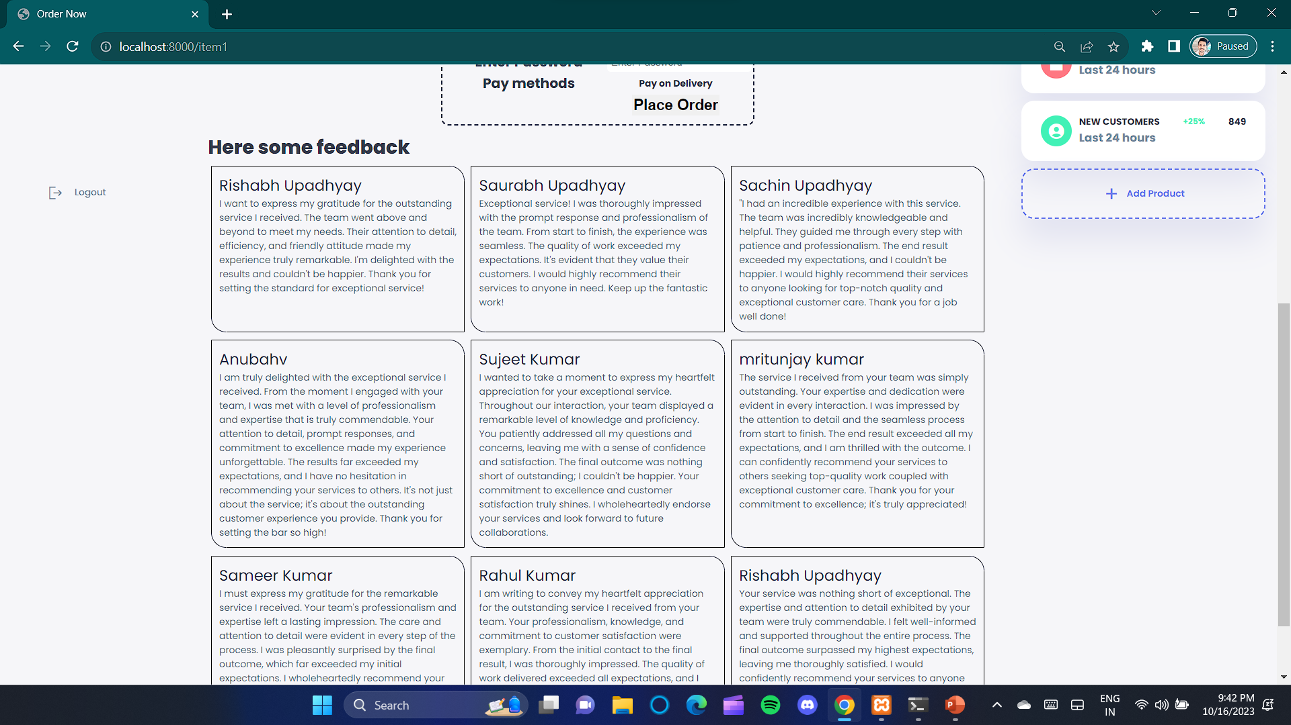
All the feedback can be seen at this page done by user Before or after ordering their food.

Slide 17
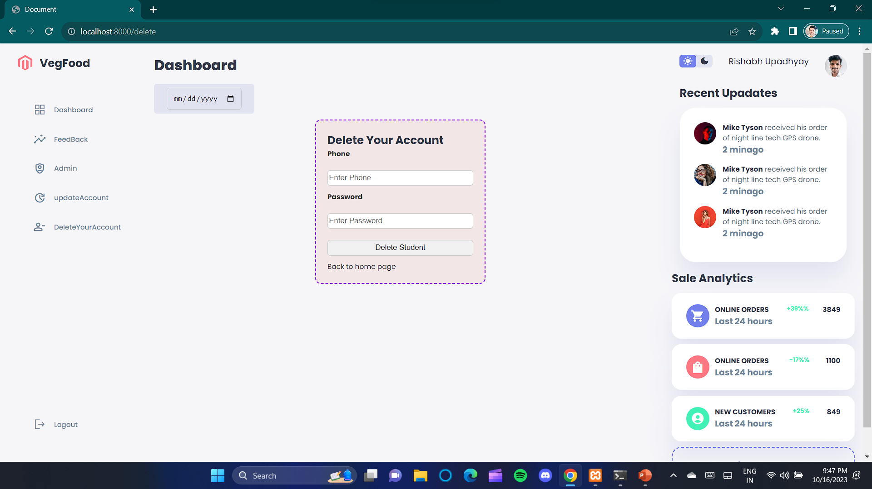
From this section you can delete your account.

Slide 18
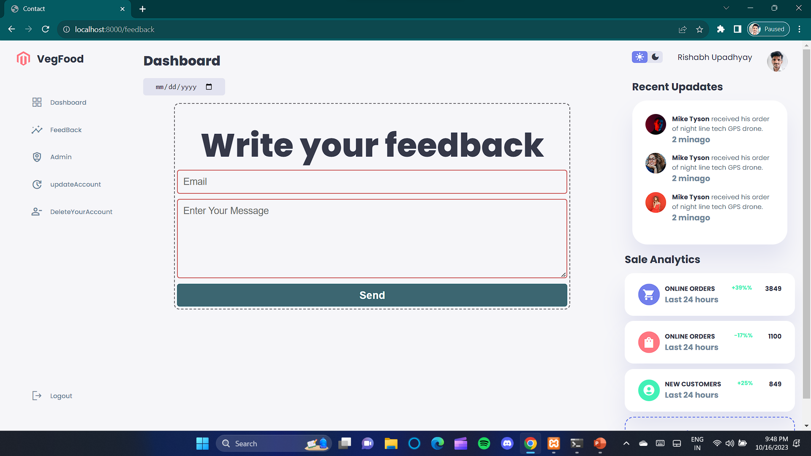
Using this page you can simply give your feedback
On our services which will store on database and will reflect on orders page.

Slide 19
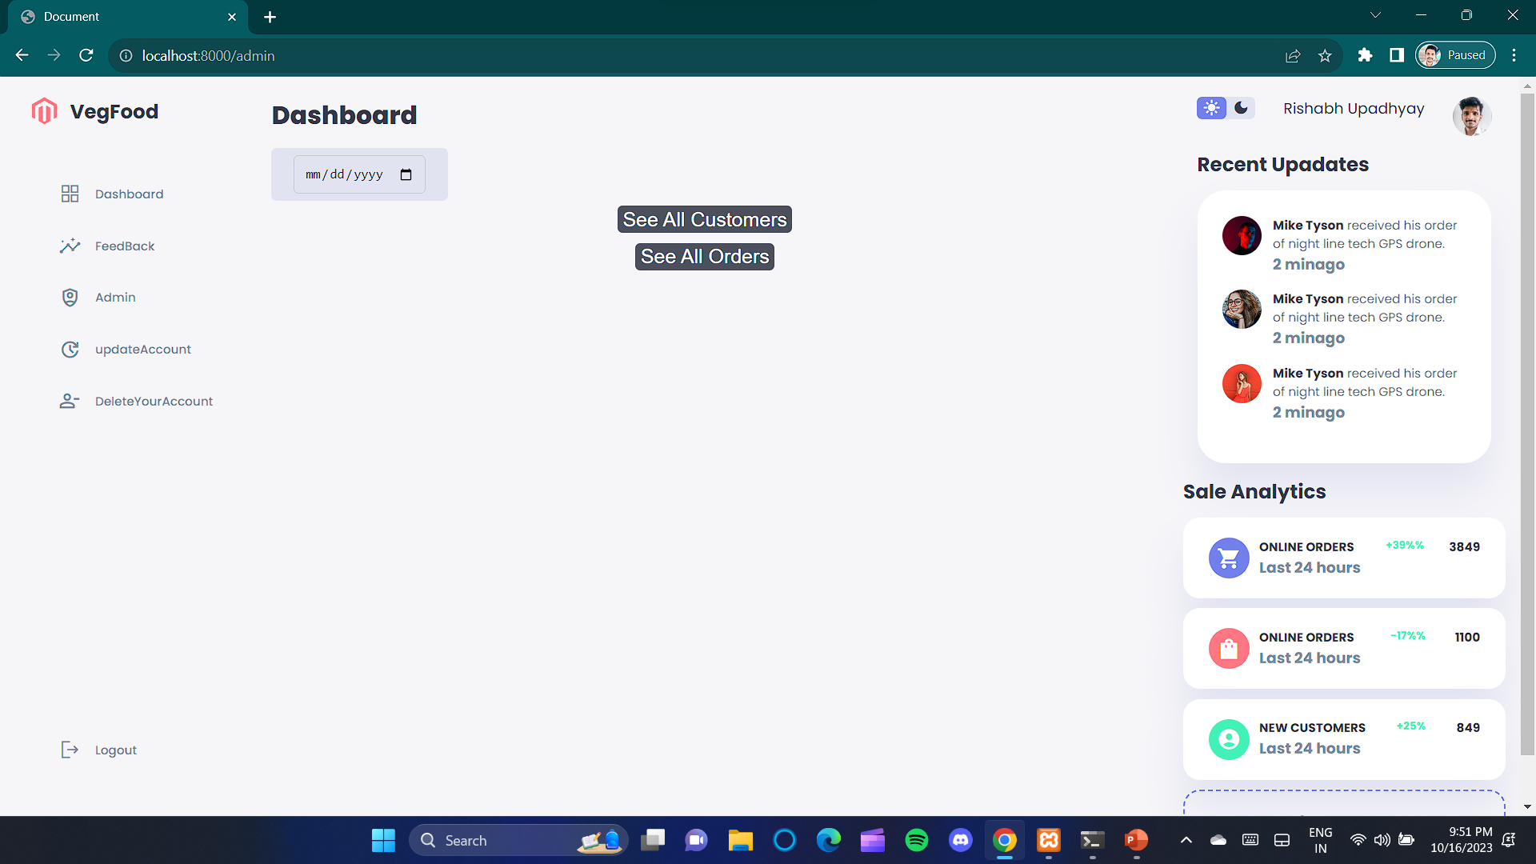
As admin you can see orders and number of customers and their names.

Slide 20
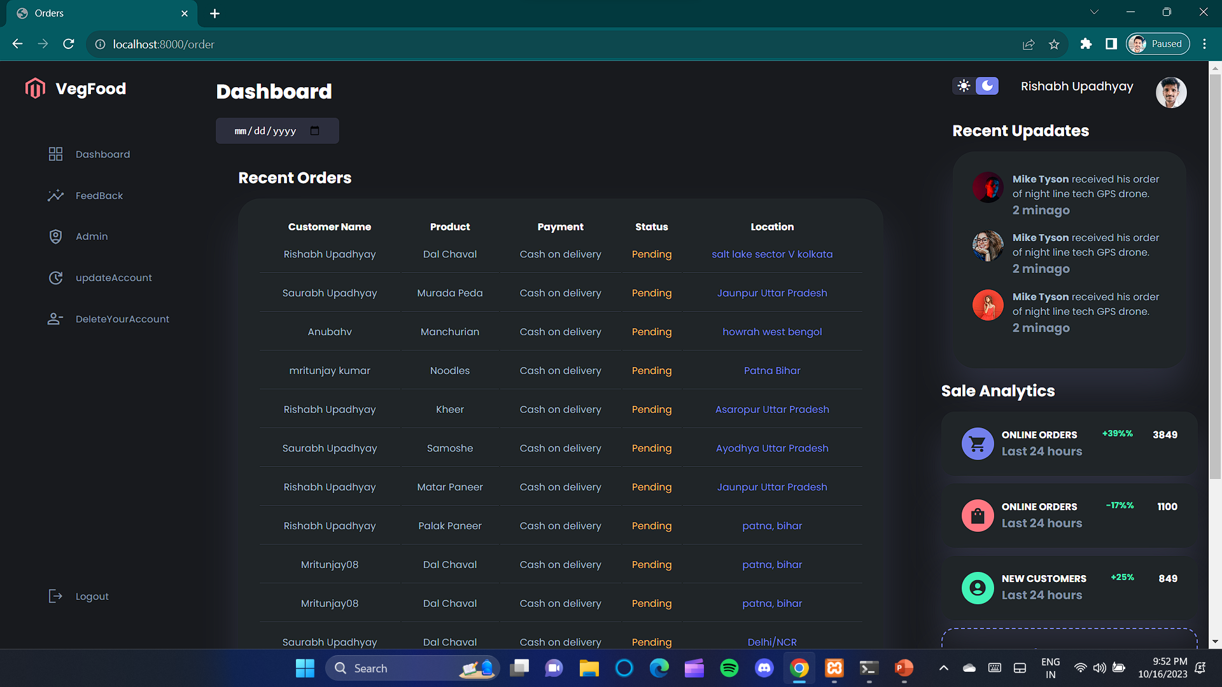
Here admin can see all the orders which have to be completed.

Slide 21
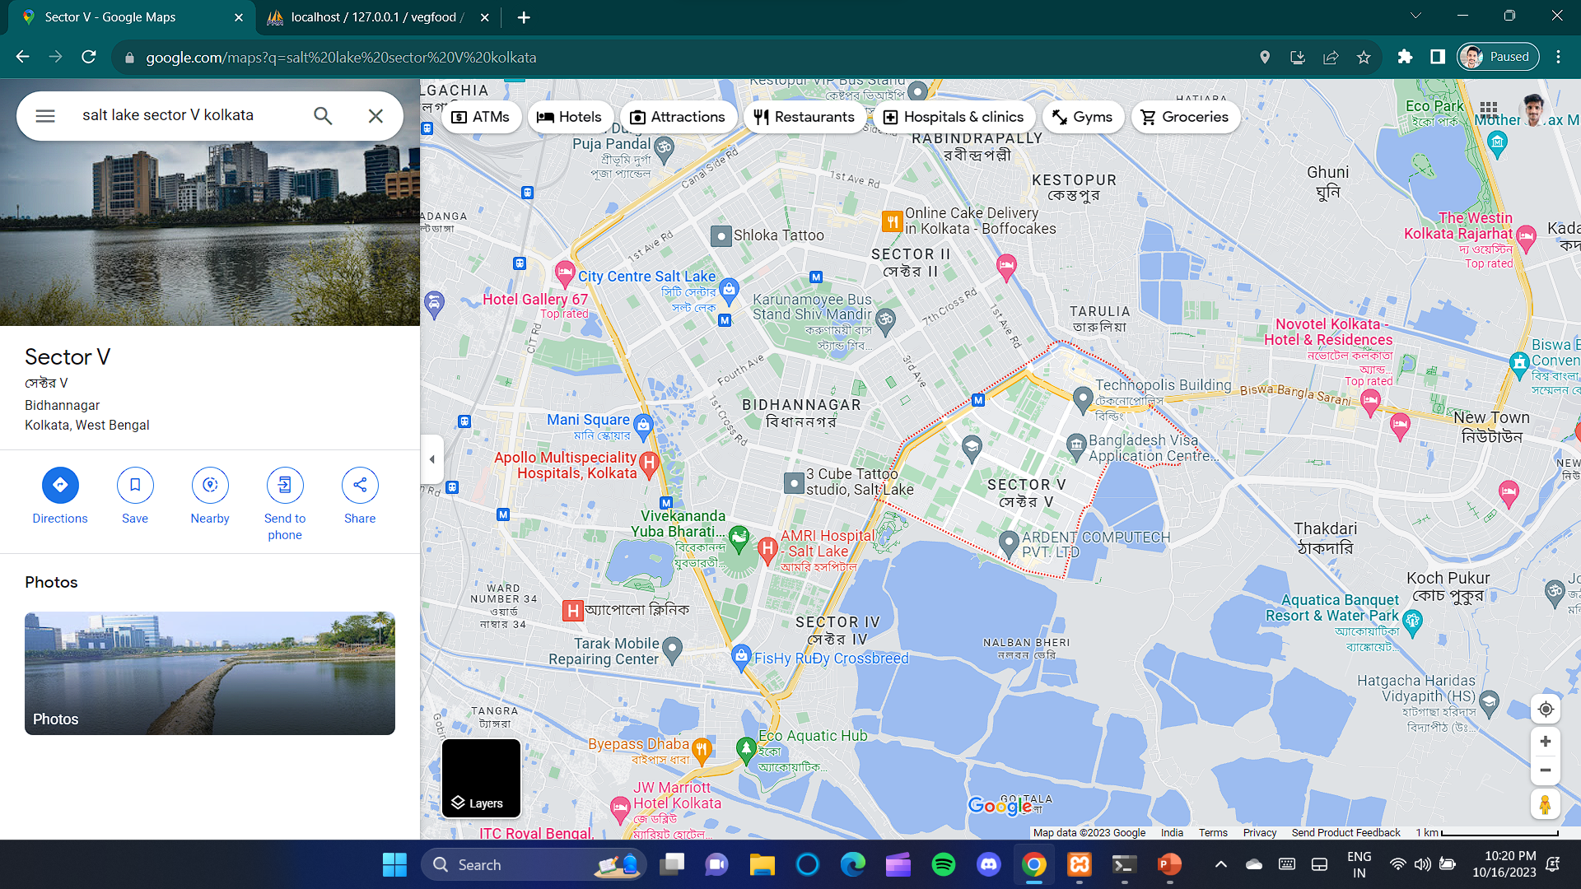
Used navigation system to go to location of customer who have ordered.

Slide 22
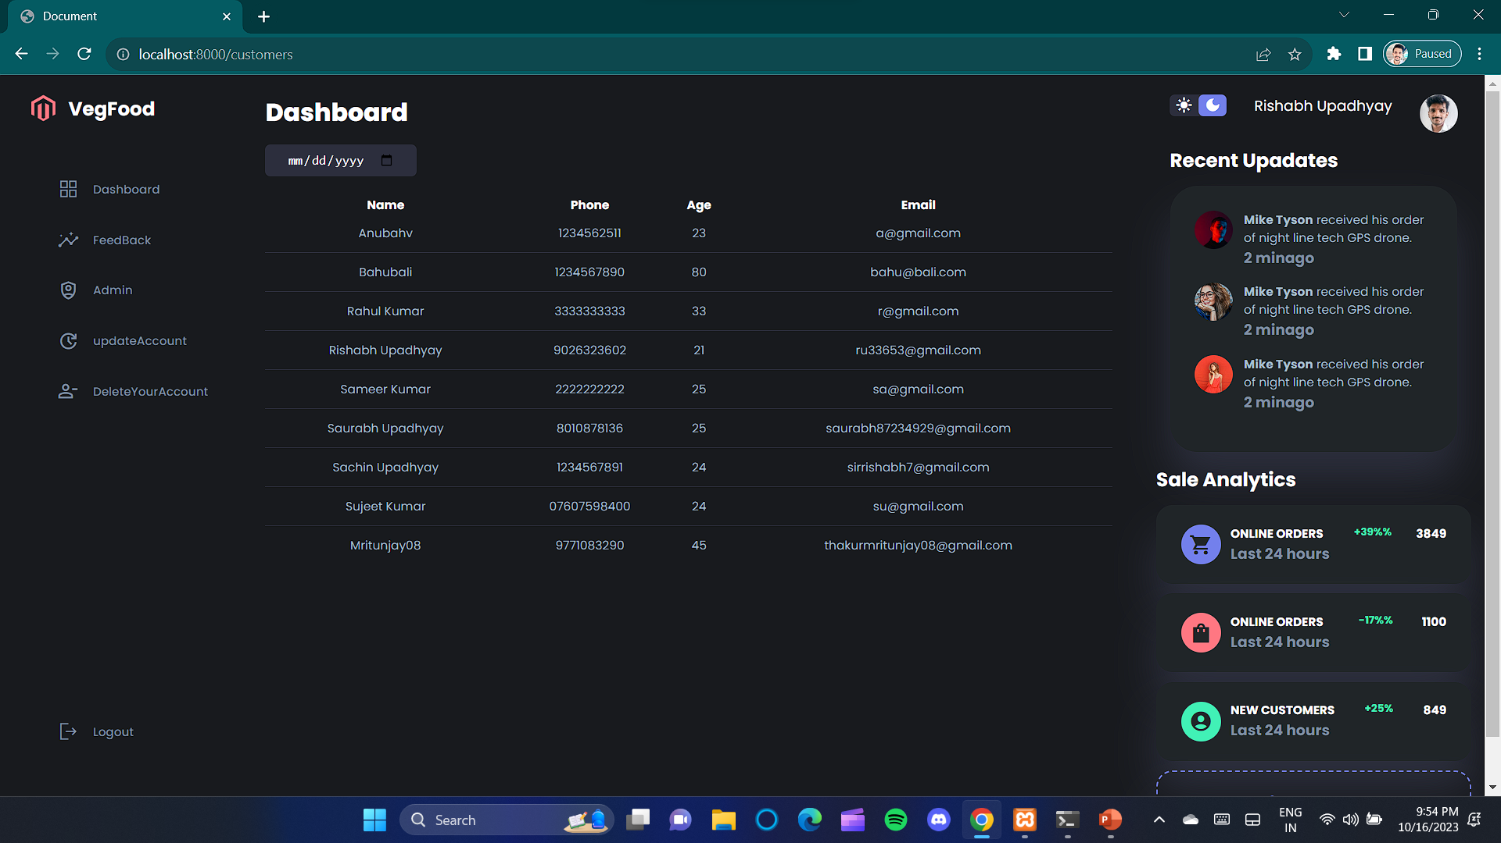
Here admin can see all the user name stored in database.

Slide 23

Using logout button you can log out.

Slide 24
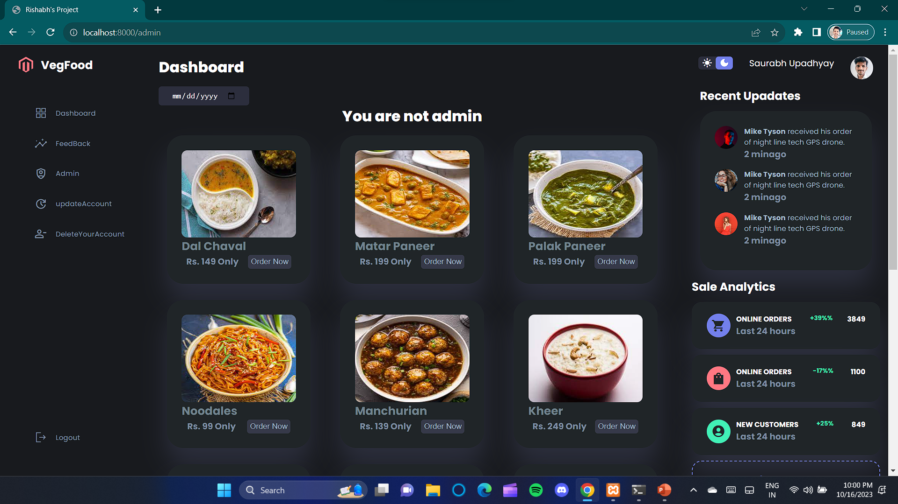
As admin you will have extra power.

Slide 25
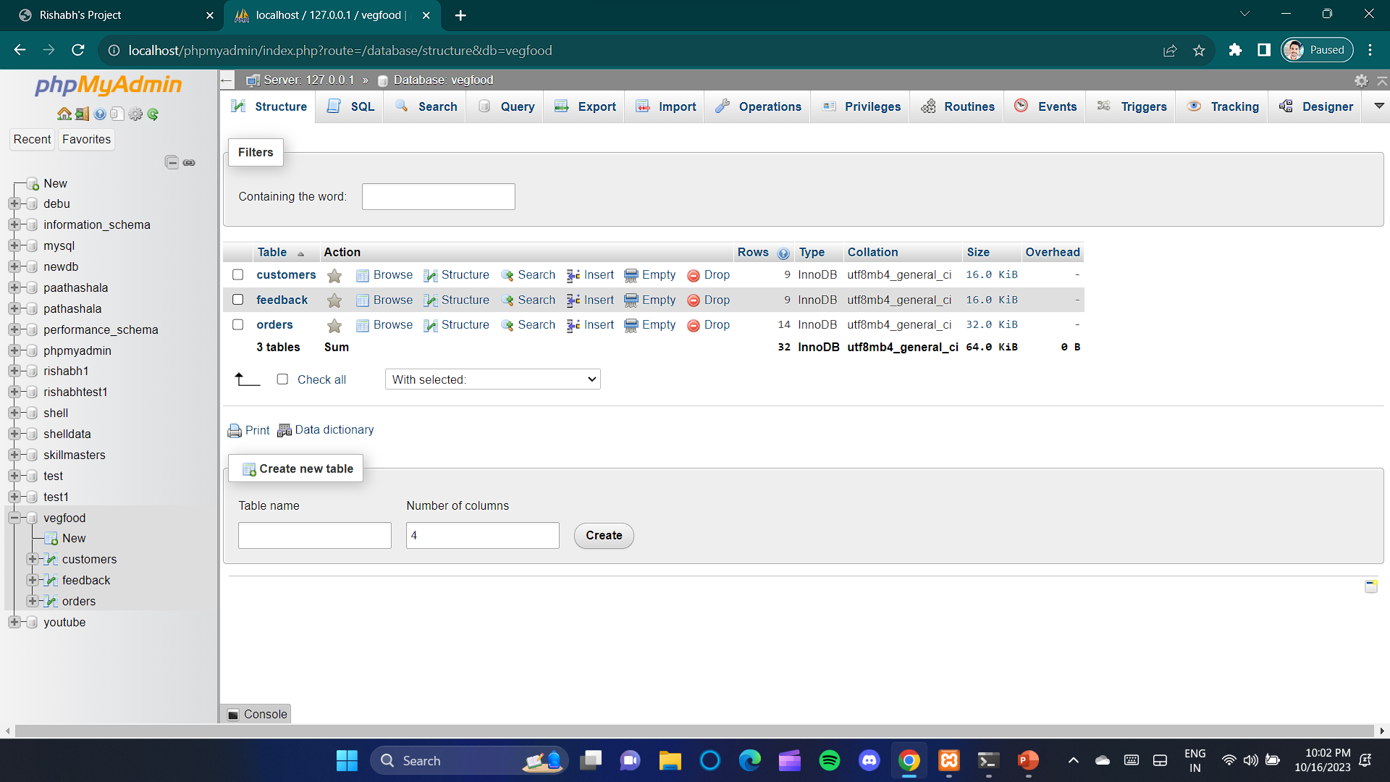
I have made three tables in database vegfood.

Slide 26
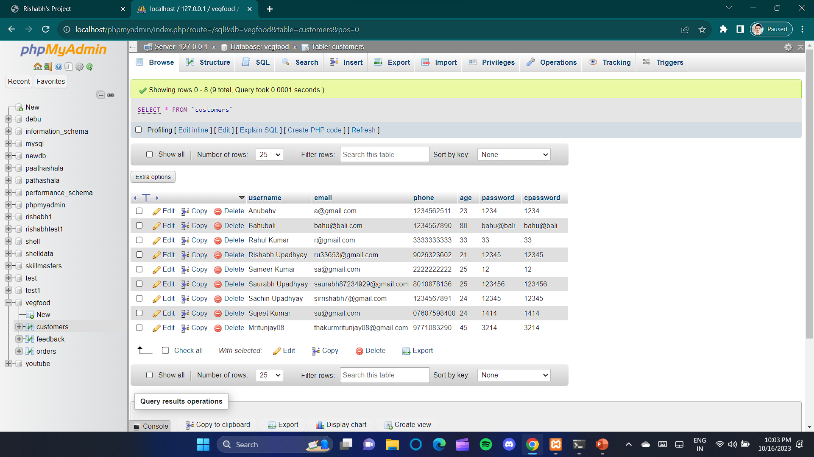
Customers table.

Slide 27
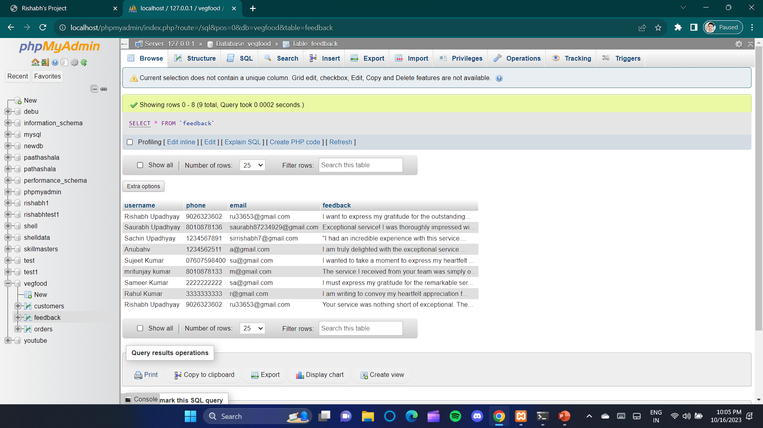
Feedback table.

Slide 28
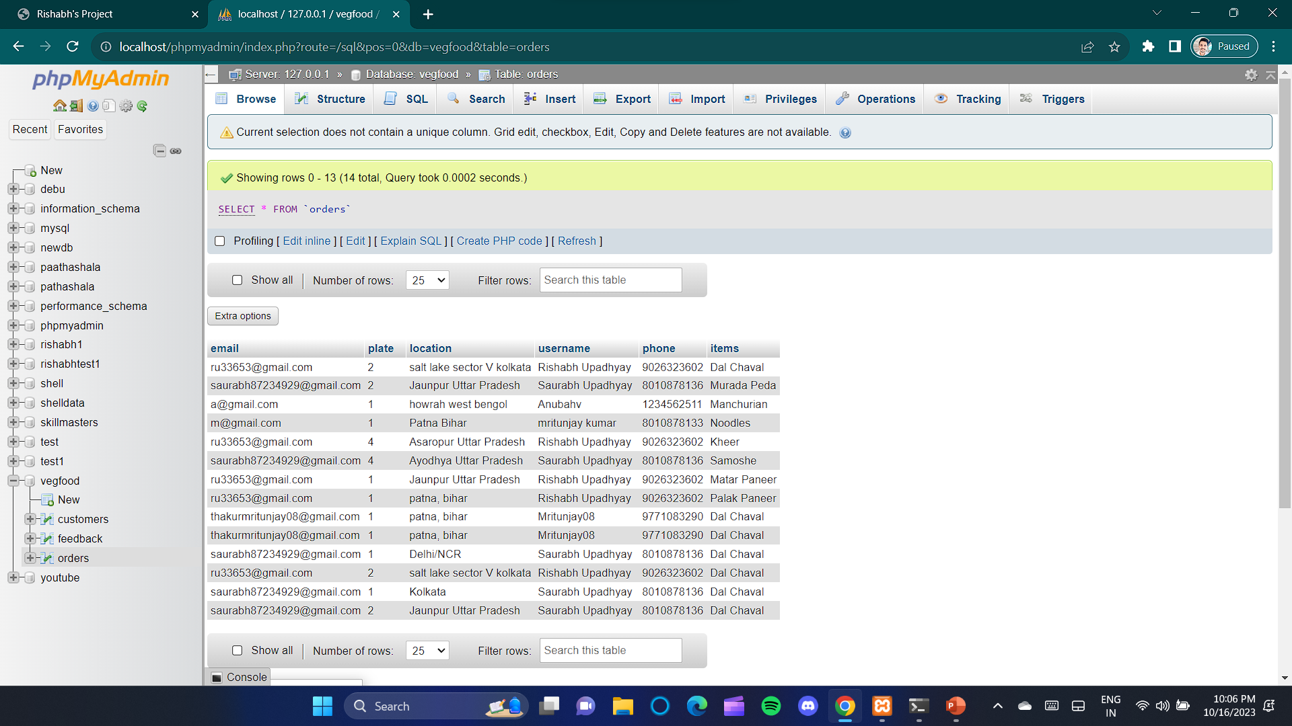
Orders table.

Slide 29
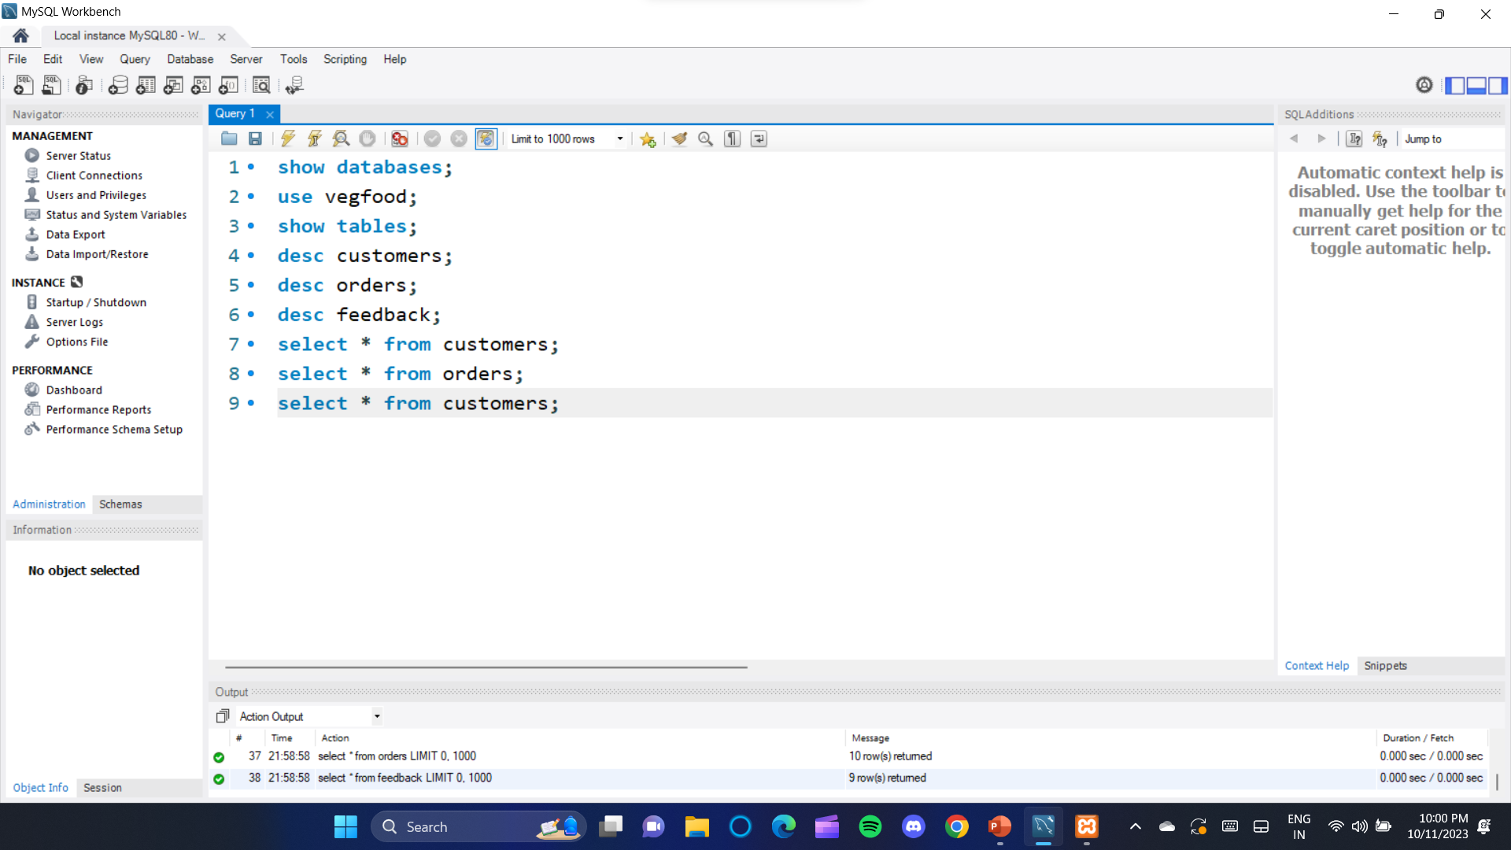
Now I am using MySQL workbench to show my databases and stored data. These are 9 commands to see database and their data.

Slide 30
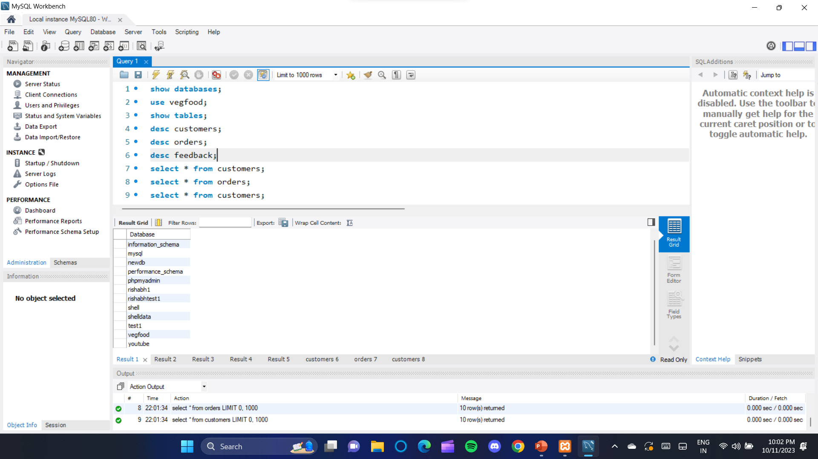
Executing this query.
Here all the database and for this project vegfood is database.

Slide 31
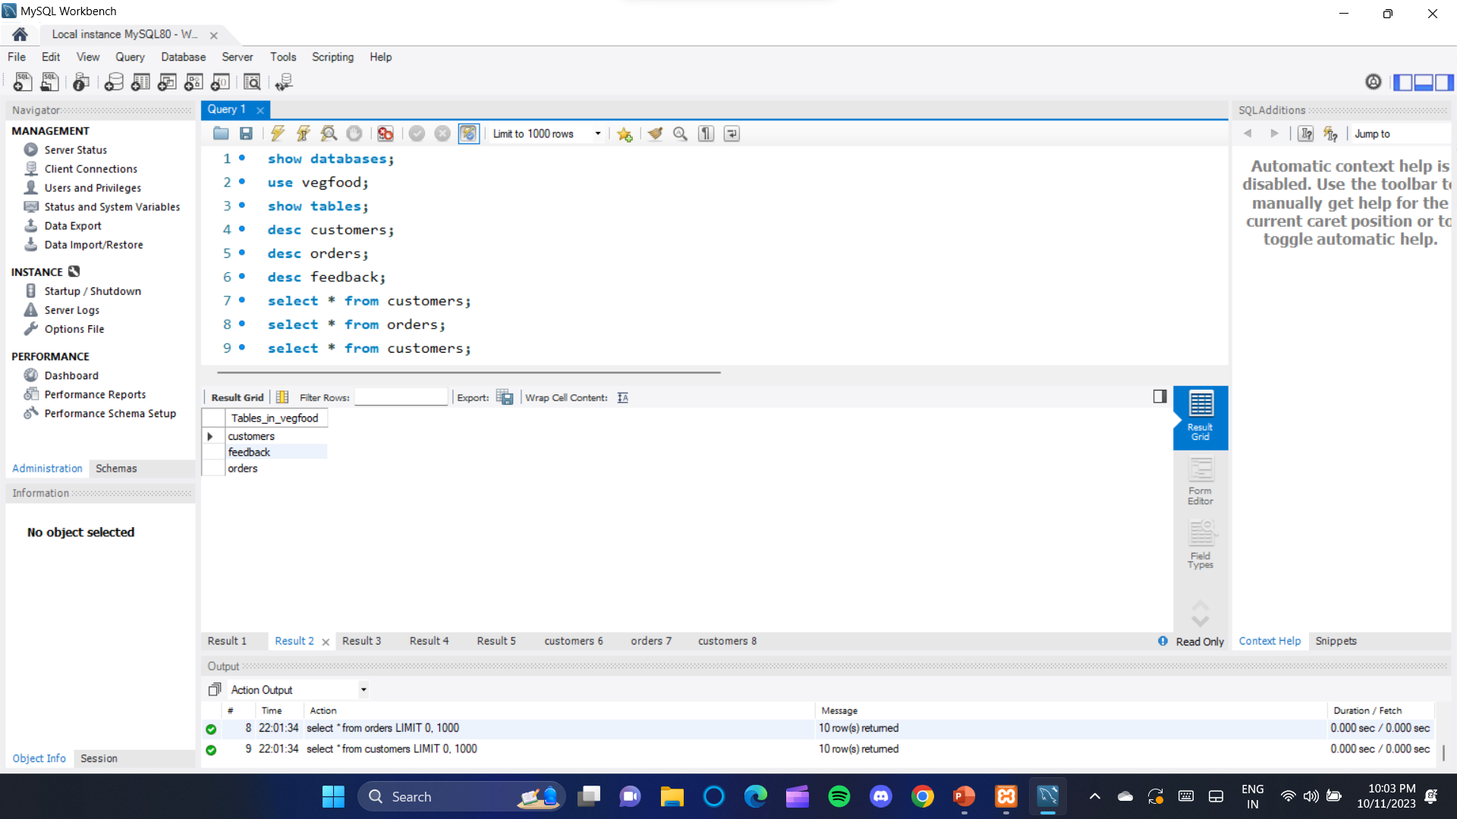
Executing this query.
All the tables stored in database.

Slide 32
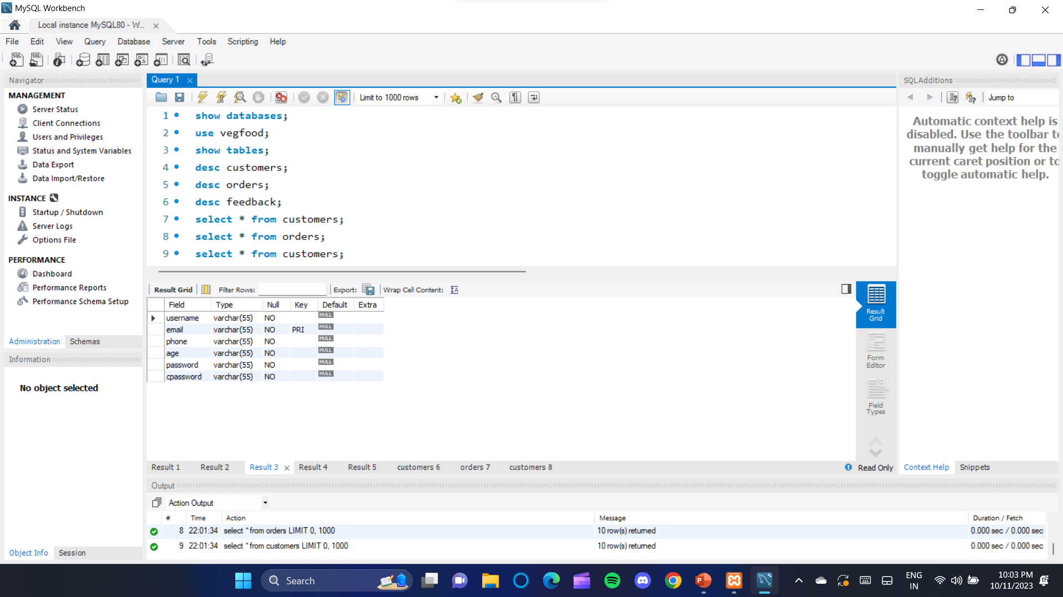
Executing this query.
Here customers table description.

Slide 33

Executing this query.
Orders table description.

Slide 34
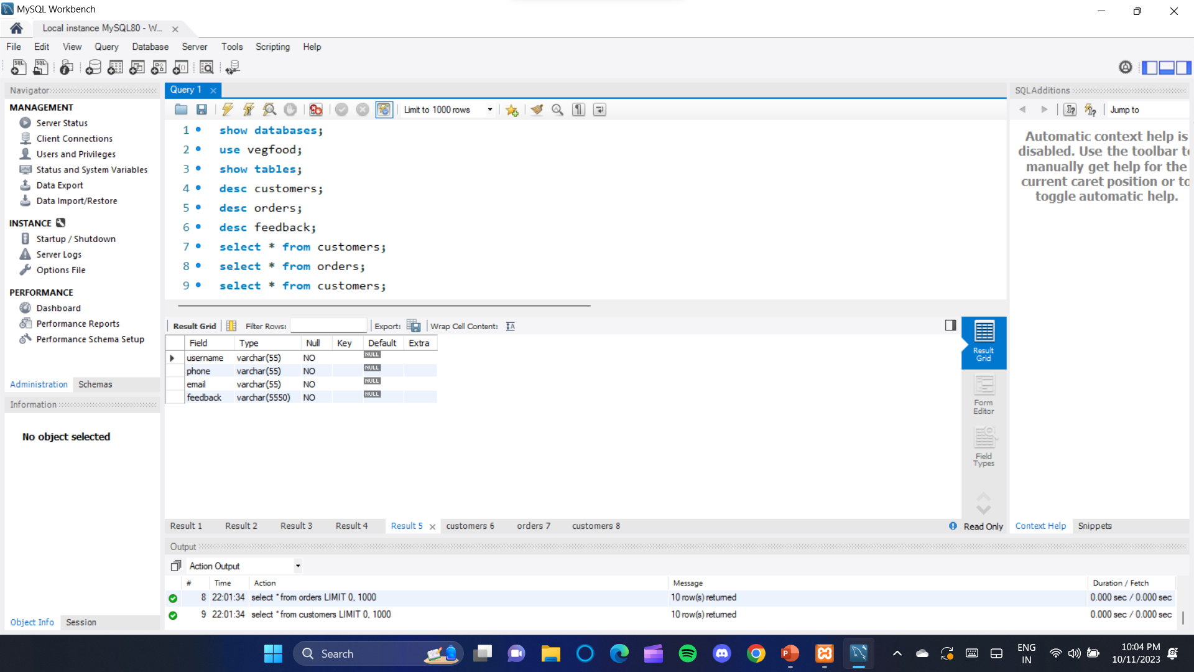
Executing this query.
Feedback table description.

Slide 35
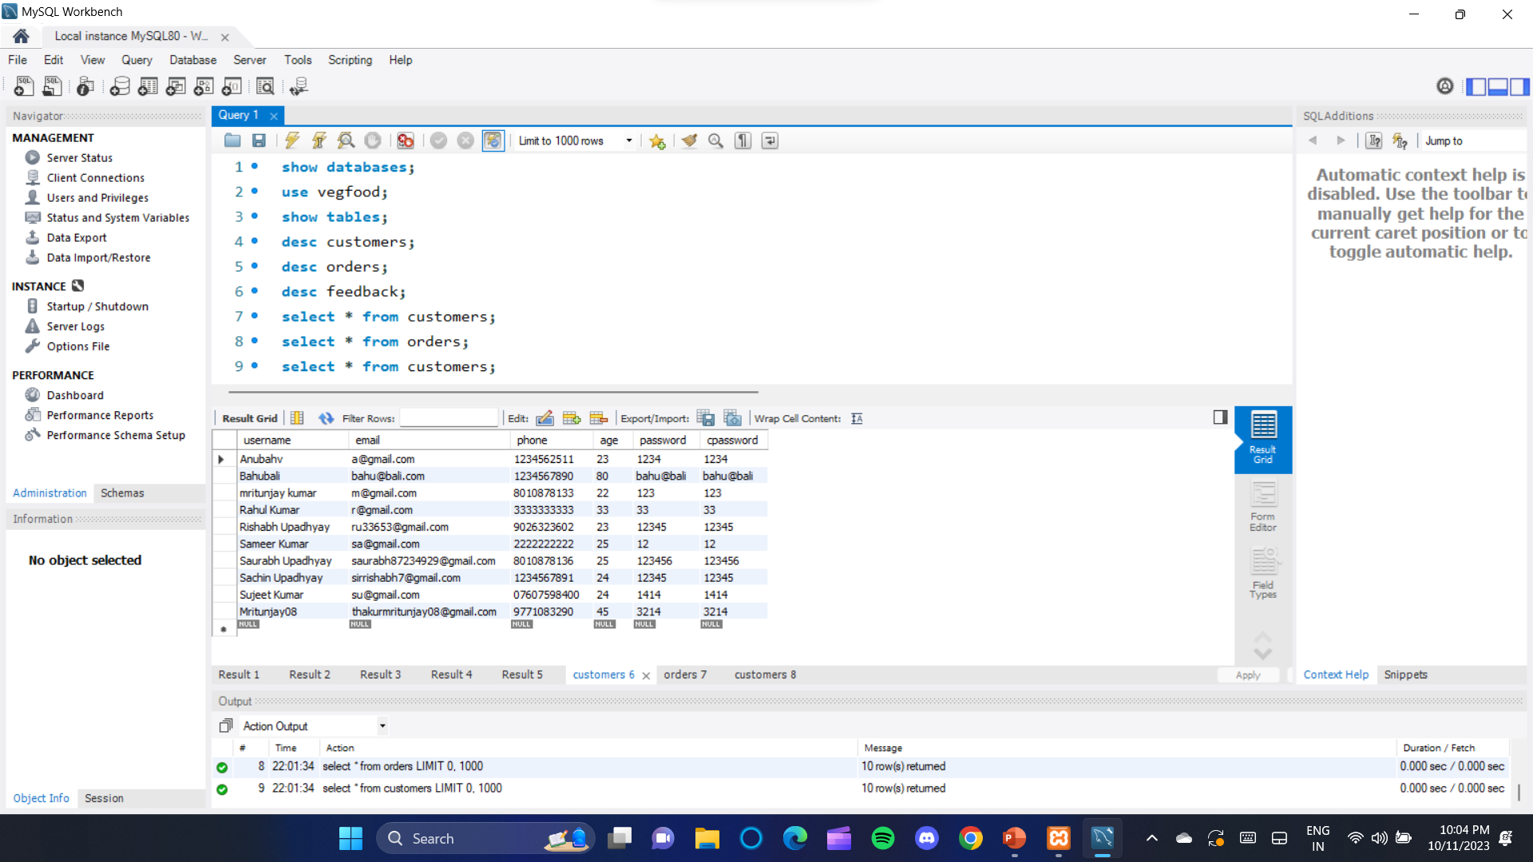
Executing this query.
Customers table.

Slide 36
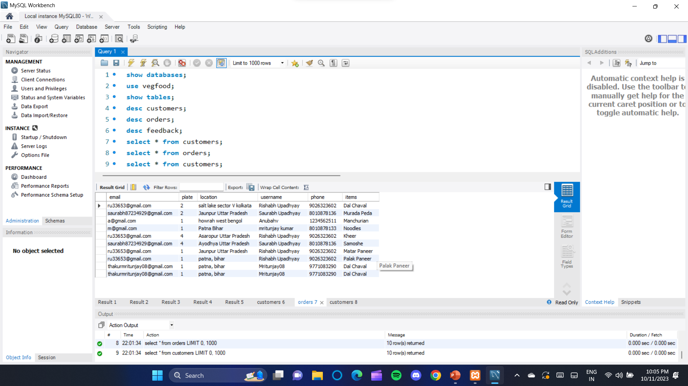
Executing this query.
Orders table

Slide 37
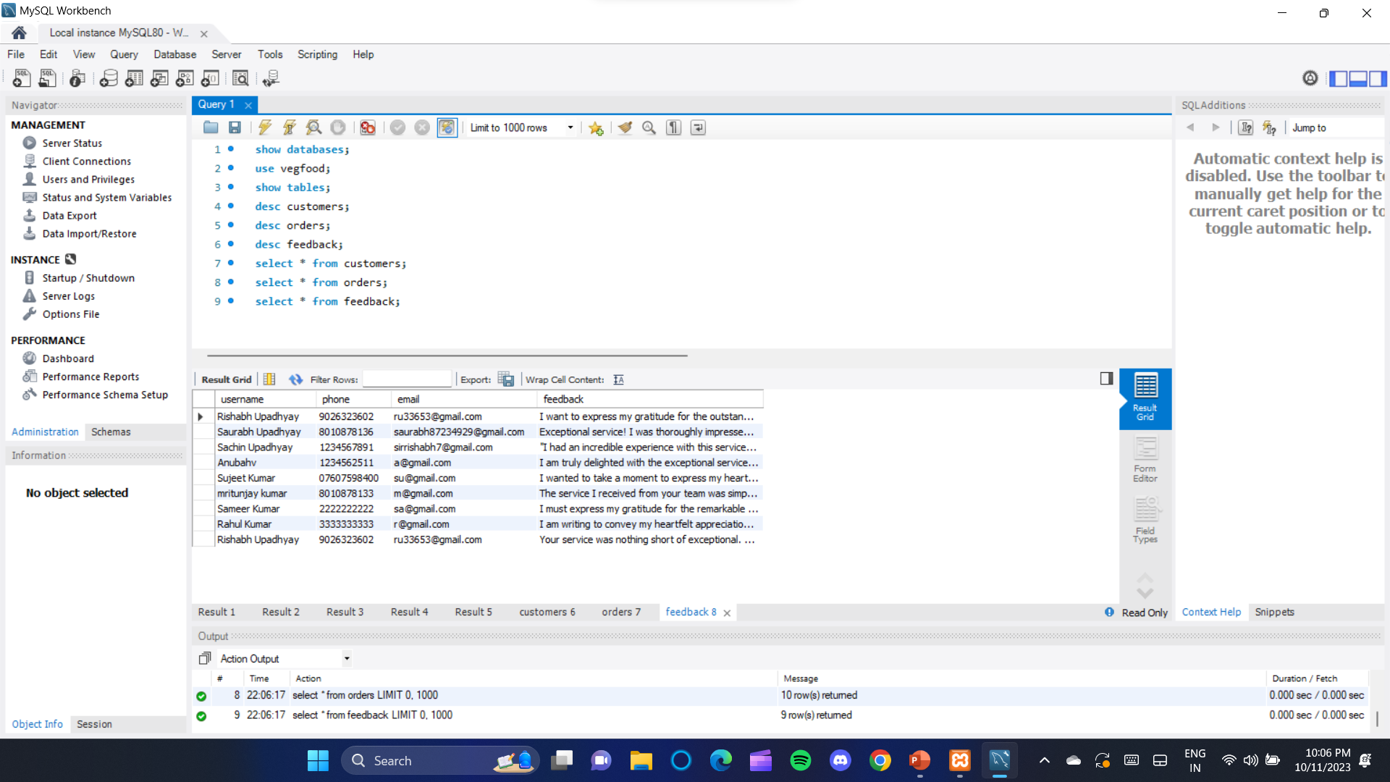
Executing this query.
Feedback table.

Slide 38
Thanks

